Slide 1

BOKEH Advanced Programming for Business Analytics - Midterm
Cristian Castillo Escajadillo

Slide 2

What is Bokeh?
In Photography, Bokeh is a visual effect that adds depth and visual interest to photos, drawing attention to the subject by making it stand out against a pleasantly blurred background.
In Data Science, Bokeh is a data visualization library for Python that allows users to create interactive plots, dashboards, and applications with streaming datasets.
Initially developed by Continuum Analytics, Bokeh has been contributed to the Bokeh Software Foundation.

Slide 3
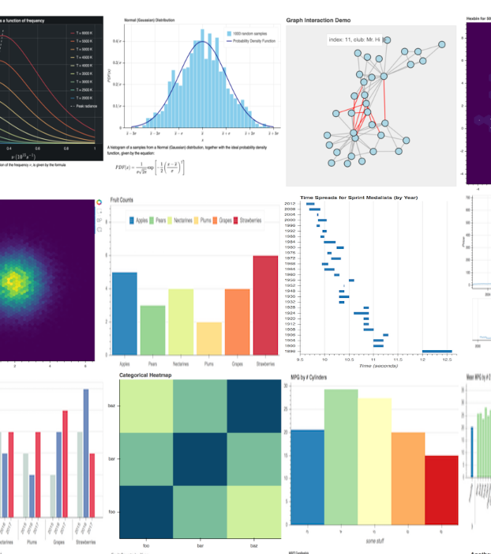
Why Use Bokeh?
Key Features:
Interactive Plots: Bokeh enables the creation of interactive plots with advanced features like zooming, panning, and hovering, providing users with an immersive data exploration experience.
Widgets for Interactivity: Bokeh offers a rich set of interactive widgets such as sliders, buttons, and dropdowns, allowing users to dynamically manipulate and control visualizations according to their analysis requirements.
Rich Set of Plot Types: Bokeh provides a diverse range of plot types including line plots, scatter plots, bar plots, heatmaps, and more. This versatility caters to a wide array of data visualization needs, ensuring flexibility and adaptability in representing various datasets.

Slide 4
Why Use Bokeh?
Key Features:
4. Web-Based Visualizations: Bokeh's generates JavaScript-powered visualizations seamlessly, eliminating the need for direct JavaScript coding, and enabling the creation of interactive and visually compelling web-based visualizations.
5. Real-time Data Streaming: Bokeh supports streaming data visualization, making it well-suited for applications that require real-time updates such as monitoring systems or live data feeds.
6. Integration with Jupyter Notebooks: Bokeh seamlessly integrates with Jupyter Notebooks.

Slide 5

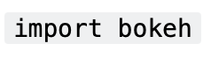
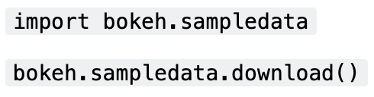

Getting Started with Bokeh
1. Installation:
To begin using Bokeh, install it via pip:
After installation, import Bokeh into your Python environment:
To check the version of Bokeh you have installed, use:
2. Sample Datasets:
Bokeh provides sample datasets for learning and testing purposes. To download these datasets:

Slide 6



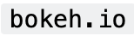
Getting Started with Bokeh
3. Interfaces:
Bokeh offers several interfaces for creating interactive visualizations:
bokeh.plotting: This interface provides a canvas for creating visualizations. Users can add glyphs (e.g., lines, circles, bars) to represent their data.
bokeh.models: The models interface offers components like tools (zooming, panning, selecting, hovering) and widgets (sliders, buttons, dropdowns) for building Bokeh plots or applications.
bokeh.layouts: This interface enables the creation of layouts containing multiple plots, arranging them in rows or columns, and applying formatting.
bokeh.io: Bokeh's input-output (I/O) interface provides functions for displaying visualizations in various environments, including Jupyter notebooks, standalone HTML files, or Bokeh server applications.

Slide 7
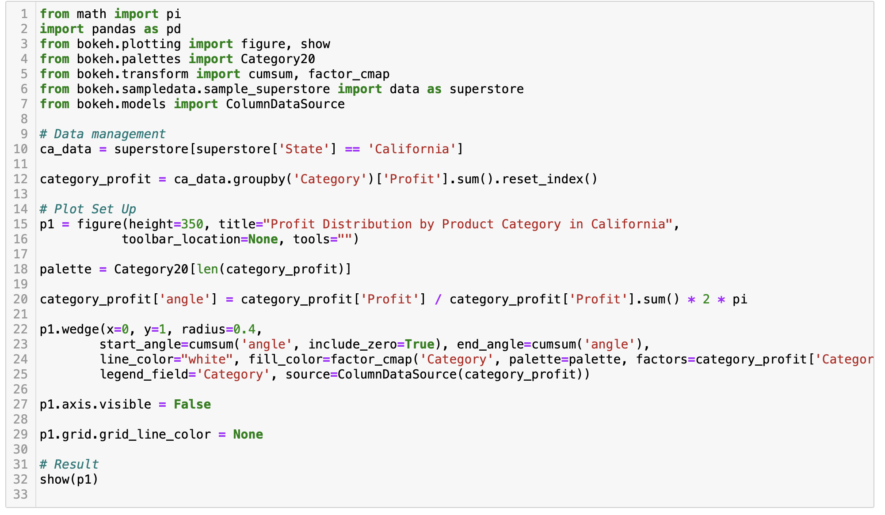
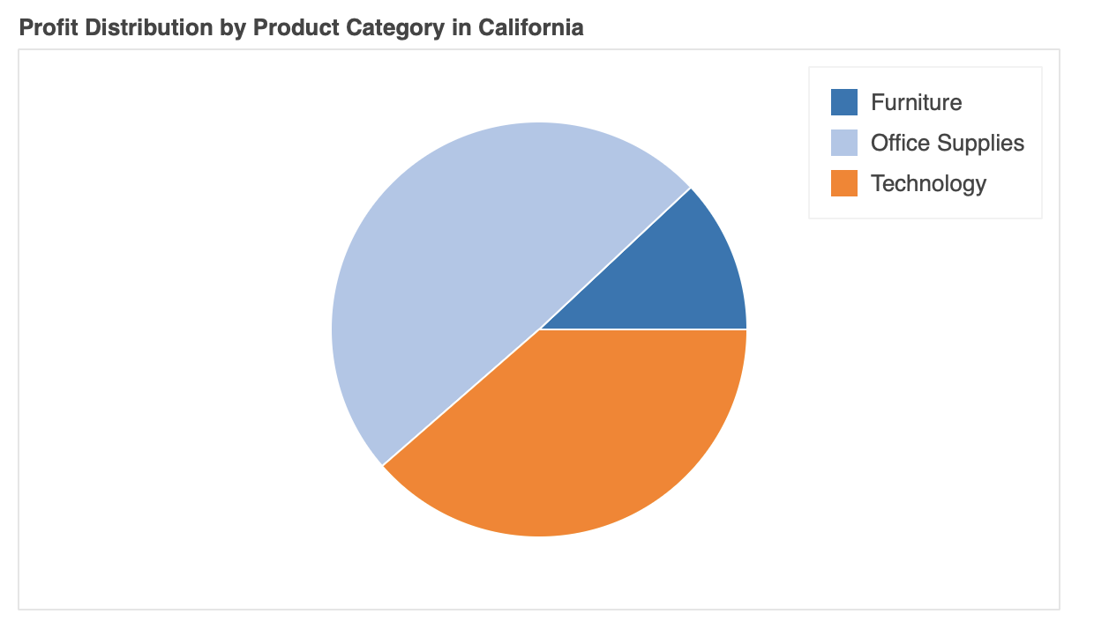
Plotting with Bokeh

Slide 8
Plotting with Bokeh
The code generates a pie chart to explore the profit distribution across different product categories in the state of California.
Data Management:
Utilizes the Bokeh library alongside pandas to handle and manipulate data.
Filters the dataset to include only data from California (superstore['State'] == 'California').
Groups the filtered data by product category and calculates the total profit for each category.
Plot Setup:
Initiates a Bokeh figure (p1) with specific attributes such as height and title.
Defines a color palette (palette) using the Category20 color scheme from Bokeh.
Calculates the angle for each category wedge based on its profit contribution, preparing the data for pie chart visualization.
Configures a wedge plot using p1.wedge(), with parameters for position, radius, angle, and color mapping.
Hides the axes and removes grid lines for a cleaner visualization.
Result:
Displays the generated visualization (p1) using the show() function from Bokeh, showcasing the profit distribution by product category in California.

Slide 9
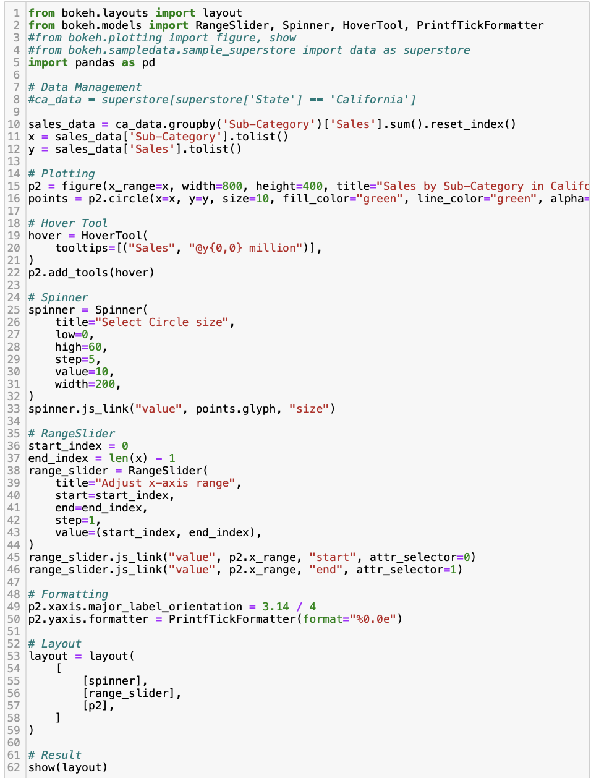
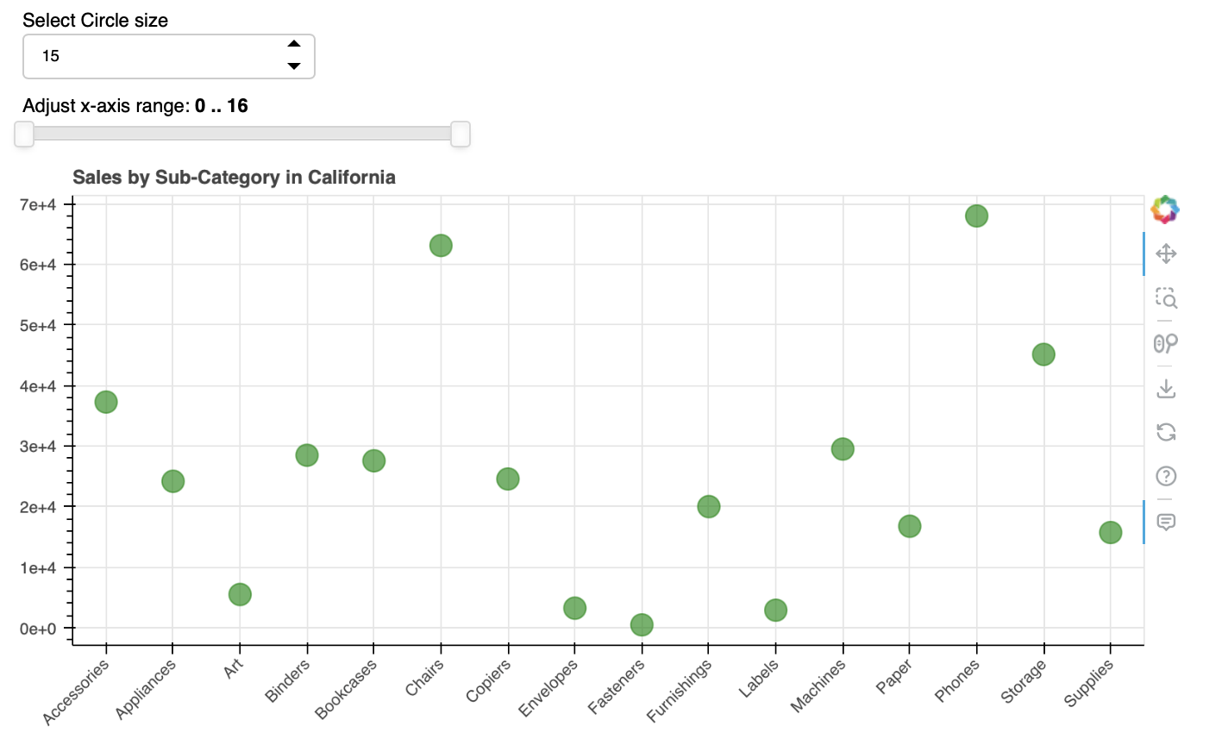
Widgets and Layouts

Slide 10
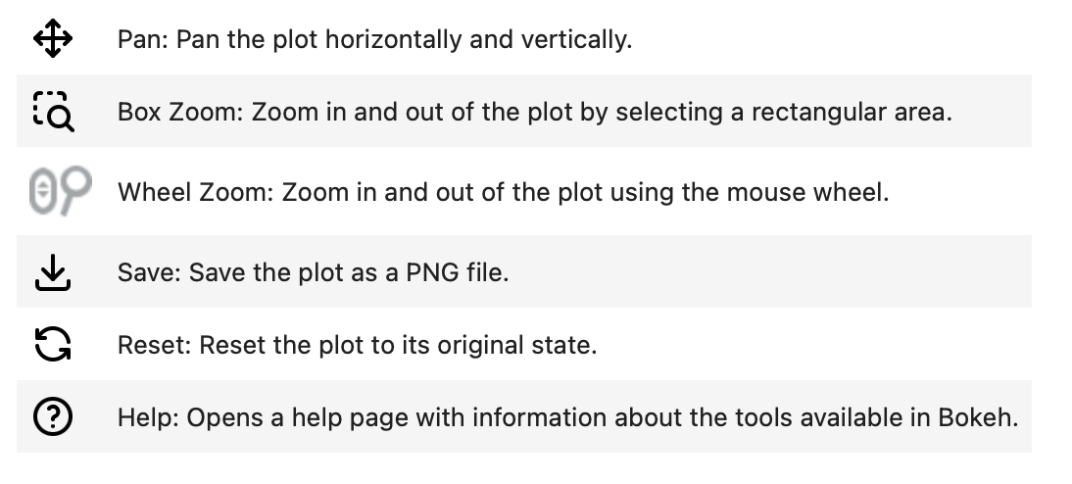
Widgets and Layouts

Slide 11
Widgets and Layouts
This code aims to visualize sales data based on sub-categories in the state of California, providing insights into product performance.
Data Management:
Groups the sales data by sub-category and calculates the total sales for each category.
Plot Setup:
Initializes a Bokeh figure (p2) with specific attributes such as x-range, width, and height.
Generates circle glyphs to represent the sales data, with customizable attributes like size, fill color, and line color.
Incorporates a Hover Tool (hover) to display sales values as tooltips when hovering over the data points.
Interactivity:
Implements a Spinner widget (spinner) for users to dynamically adjust the circle size in the plot.
Includes a RangeSlider widget (range_slider) to enable users to control the x-axis range for better data exploration.
Formatting:
Formats the x-axis labels with a 45-degree orientation for improved readability.
Utilizes PrintfTickFormatter to format the y-axis labels in scientific notation (e.g., 1.23e+06).
Layout:
Constructs a layout structure containing the spinner, range slider, and plot components for presentation.

Slide 12
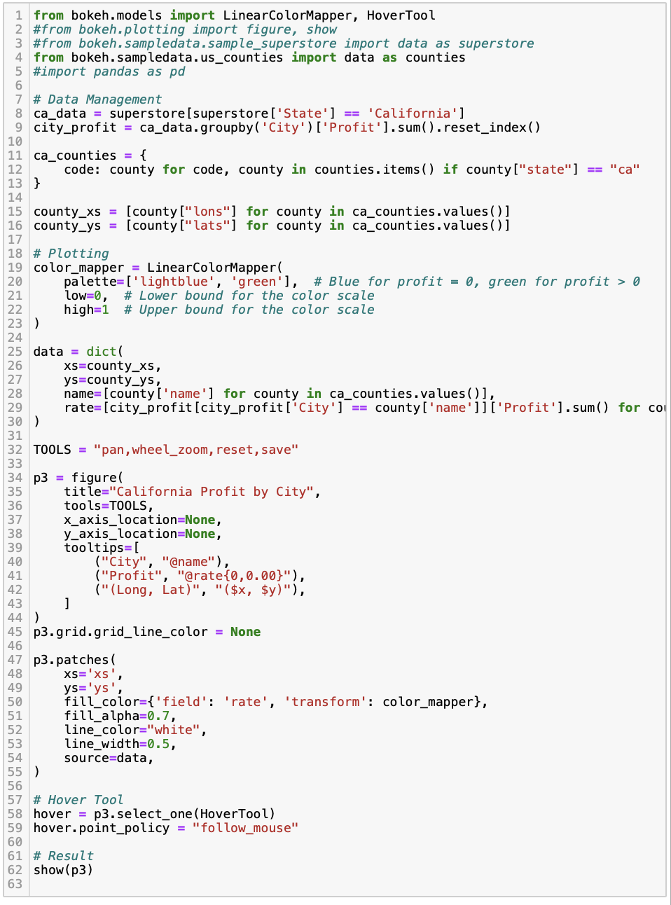
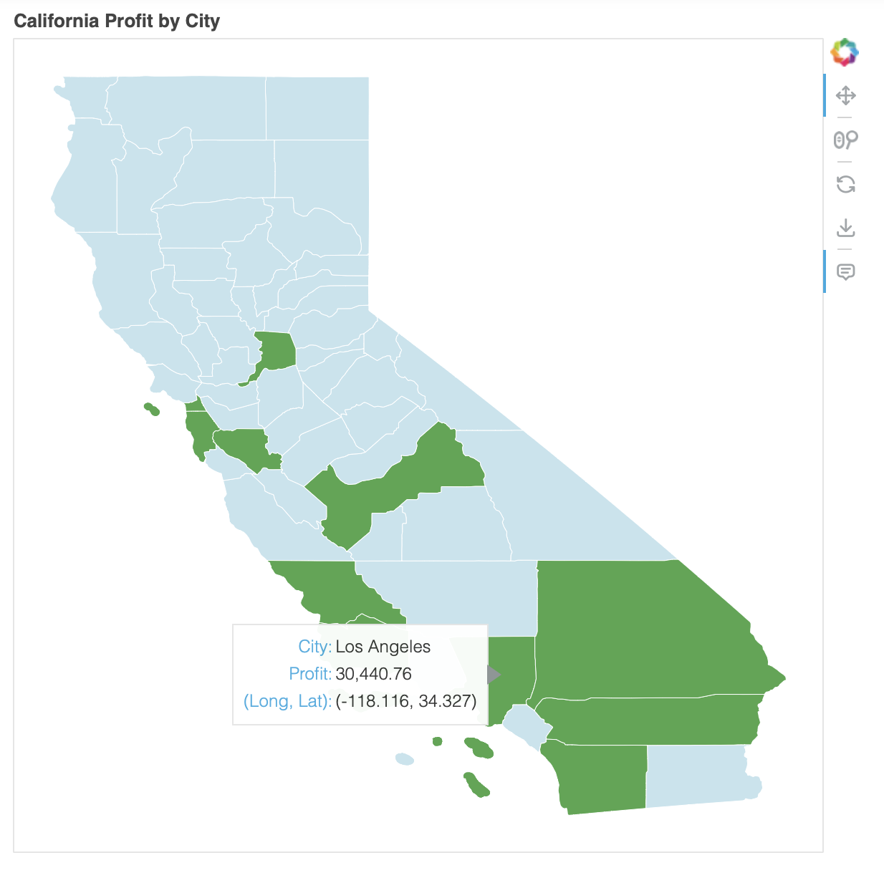
Geographical Data

Slide 13
Geographical Data
The code generates a visualization of the profit distribution across cities in the state of California, providing insights into regional profitability.
Data Management:
Aggregates profit data by city (city_profit).
Retrieves geographic data for California counties from Bokeh's sample dataset (counties).
Configures a linear color mapper (color_mapper) to map profit values to colors, distinguishing positive and negative profits.
Constructs a dictionary (data) containing county coordinates, city names, and corresponding profit rates.
Plotting Setup and Interactivity:
Initializes a Bokeh figure (p3) with specific attributes such as title, tools, and tooltips.
Utilizes the patches() method to render polygons representing California counties, with fill colors based on profit rates.
Incorporates a Hover Tool to display city names and profit values as tooltips when hovering over the data points.

Slide 14
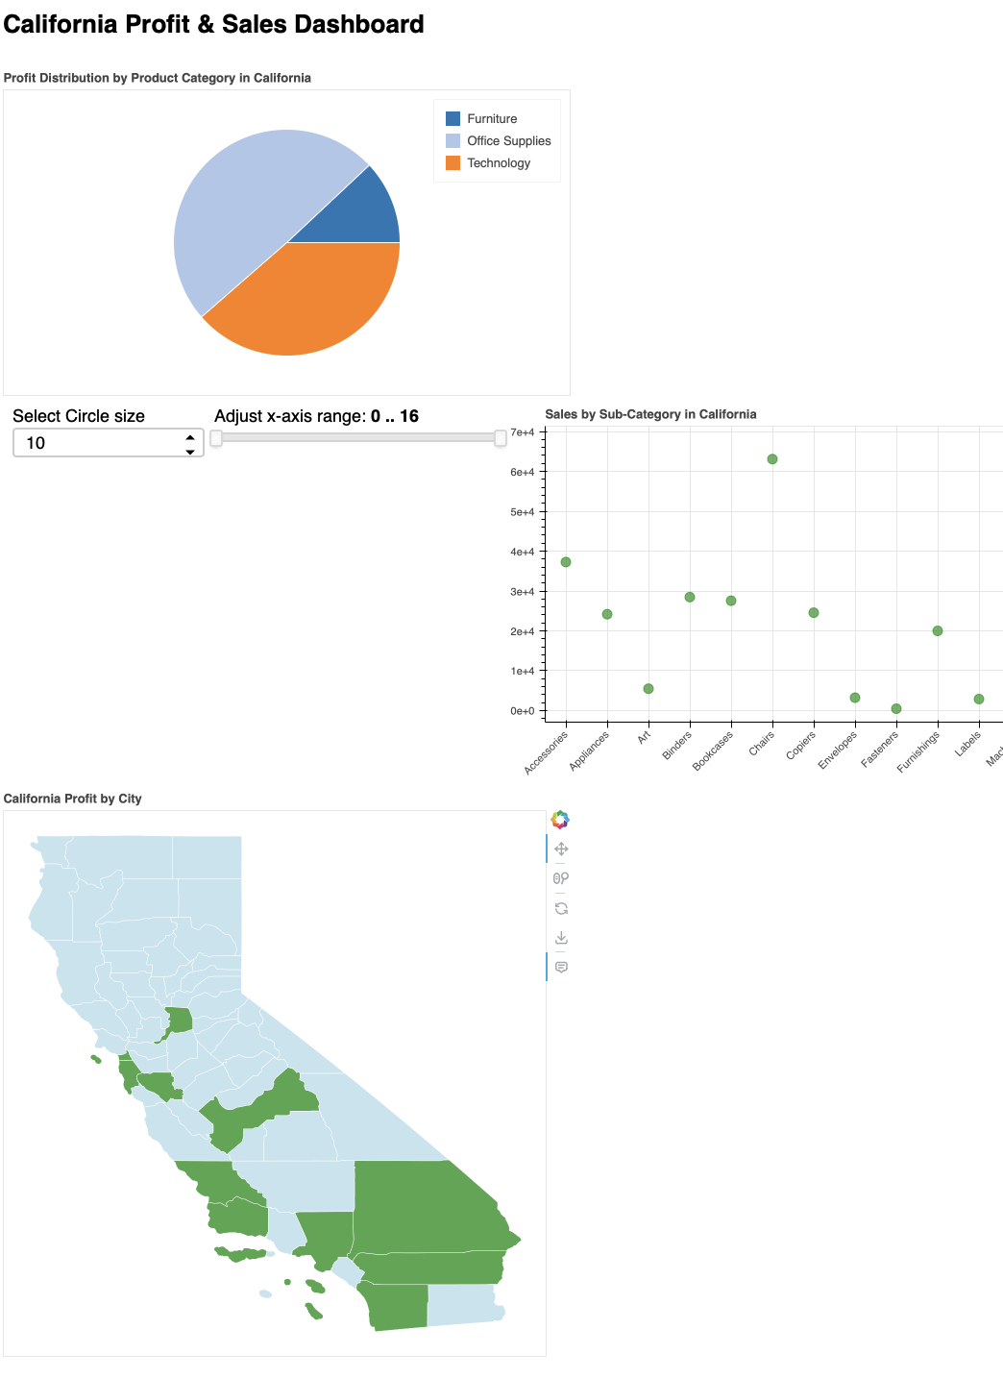
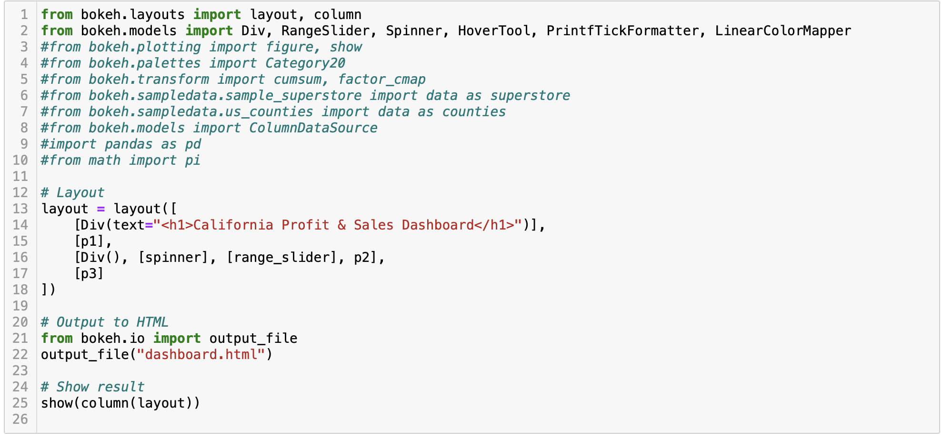
Dashboard

Slide 15
Dashboard
The code presents a dashboard that includes the three visualizations shown.
Layout and Structure:
The layout is organized using Bokeh's layout module, containing multiple rows for different components.
Incorporates a header (<h1>) with the title "California Profit & Sales Dashboard" for clear identification.
Components:
Plot 1 (p1): Represents the profit distribution by product category in California.
Plot 2 (p2): Displays sales data by sub-category in California, with interactive features such as a spinner and range slider for customization.
Plot 3 (p3): Visualizes profit distribution by city in California, providing geographic insights into profitability.
Output and Presentation:
Generates an HTML output file (dashboard.html) for easy sharing and viewing.
Utilizes Bokeh's show() function to display the dashboard layout, combining all components vertically (column(layout)).

Slide 16
Advantages for Data Scientists
Interactivity: Bokeh's interactive features provide data scientists with a powerful toolset to analyze and present their findings, fostering a deeper understanding of the data.
Flexibility: Bokeh offers flexibility, catering to various visualization tasks, from exploratory data analysis to building complex dashboards, adaptable to different stages of the data science workflow.
Web Deployment: Bokeh simplifies the deployment of visualizations on the web, facilitating the sharing of results with a broader audience and enabling seamless access to insights.
Integration with Python Ecosystem: Being a Python library, Bokeh seamlessly integrates with other popular data science tools and libraries like NumPy, and Pandas, enhancing its utility and compatibility within existing workflows.

